Slide 1
Android Permissions Remystified: A Field Study on Contextual Integrity
Primal Wijesekera (UBC)
Arjun Baokar (UC Berkeley)
Ashkan Hosseini (UC Berkeley)
Serge Egelman (UC Berkeley)
David Wagner (UC Berkeley)
Konstantin Beznosov (UBC)
Presenter: Hongyang Zhao

Slide 2
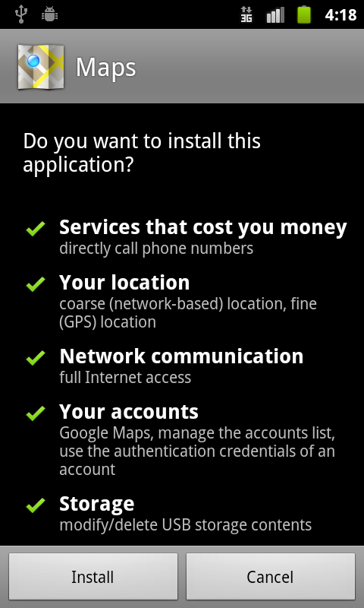
Android Permission
Android permission
Regulate how applications access protected resources
Prompt user during installation
Users’ Options
Accept permissions requested
Discontinue installing

Slide 3
Problem Statement
When developers use permissions
Not fully knowledgeable
Given too much freedom to post to Google Play Store
Not follow the principle of lease privilege
When users meet permissions
No comprehension
No contextual cues
User habituation
Lots of unnecessary application permissions are approved
Application can get access to protected resources unexpected
Notes:
There are some problems meet by developers and users.
Users don’t know when and how permissions are used by applications
If users are asked to make security decisions too frequently, they may become habituated and approve all future requests.

Slide 4
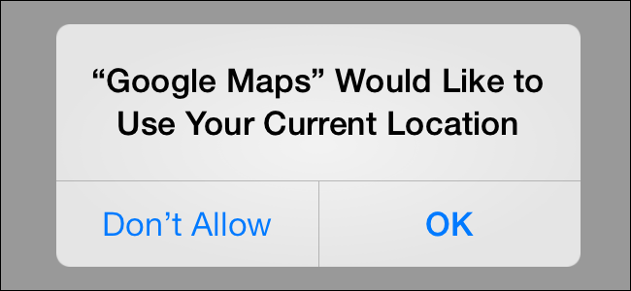
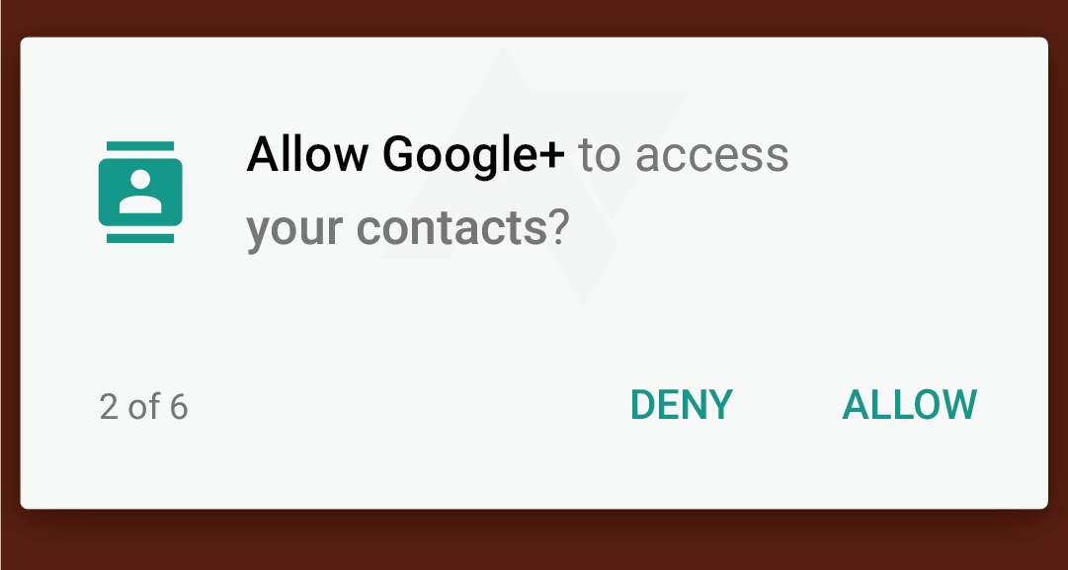
Previous solutions & Limitation
Prompt permission request at run-time
Action is not reversible
Data is sensitive
Incurs additional cost
Too many prompts
Notes:
Reading location data. Location data, we can’t take it back
Sensitive: reading browser history
Sending message

Slide 5
Solution
When to actually prompt?
not reversible/sensitive/Incurs additional cost
Unexpected (“Privacy violations occur when sensitive information is used in ways defying users’ expectations”)
Goal
Confront users with necessary permission requests, not the expected, reversible, or unconcerning ones.
A. P. Felt, S. Egelman, M. FiniUer, D. Akhawe, and D. Wagner. How to Ask for Permission. Proceedings of the USENIX Workshop On Hot Topics In Computer Security (HotSec), 2012.
Notes:
Prompt permissions

Slide 6
Two steps
Instrument Android to collect data
How often and under what circumstances smartphone apps are accessing protected resources regulated by permissions?
Survey users when they exit the experiment
If given the opportunity, whether users would like to deny applications access to protected resources?
Notes:
After the experiment is finished, all..

Slide 7
Outline
Problem statement
Data collection
Application behavior
User expectation & reactions
Model users’ decision
Conclusion
Quiz

Slide 8
Data collection Procedure
Tracking access to sensitive data
Modify Android to log whenever an app accessed a protected resource
Recruitment
36/48 qualified participants from Craigslist
Exit survey
Whether resource access instances are expected
Whether users would like to deny access

Slide 9
Data collection Architecture
Producers: hook Android API call
Log protected API methods that are called
Log access to protected ContentProviders class
Log access to protected Intents
Consumer: embedded in Android service
Write data to a log file
Upload to server

Slide 10
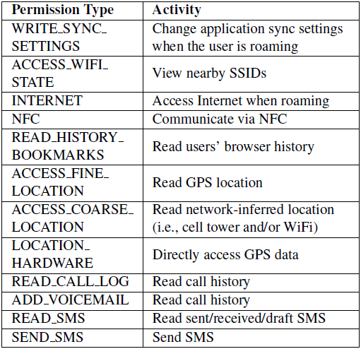
Data collection
The experiment
36 Android smartphone users
1week of real-world use
27 million permission requests (107142 requests/day/user)
12 permissions
Felt et al. recommend to be granted via runtime dialogs
Randomly take screenshots when permissions are checked
Notes:
107142 requests/day/user

Slide 11
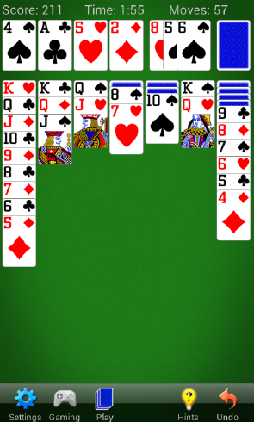
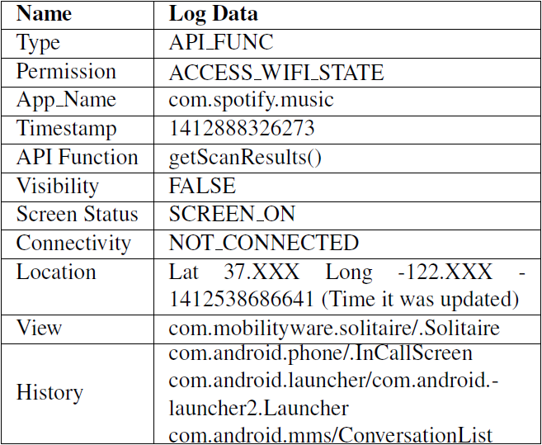
Data collection
Screenshot (cards)
Log entry (music app)

Slide 12
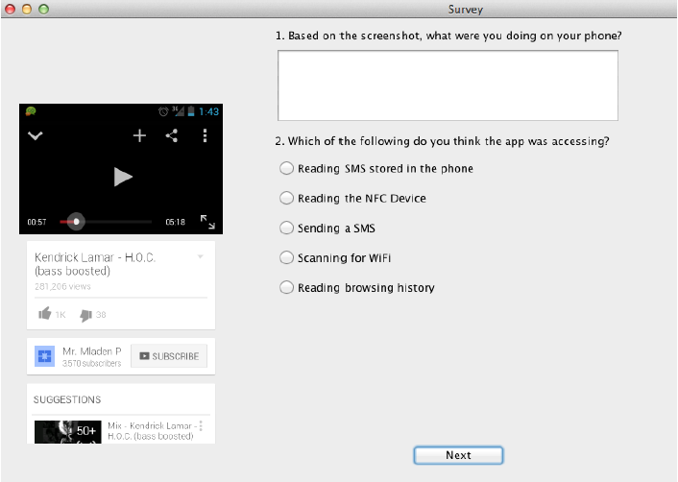
Exit Survey

Slide 13
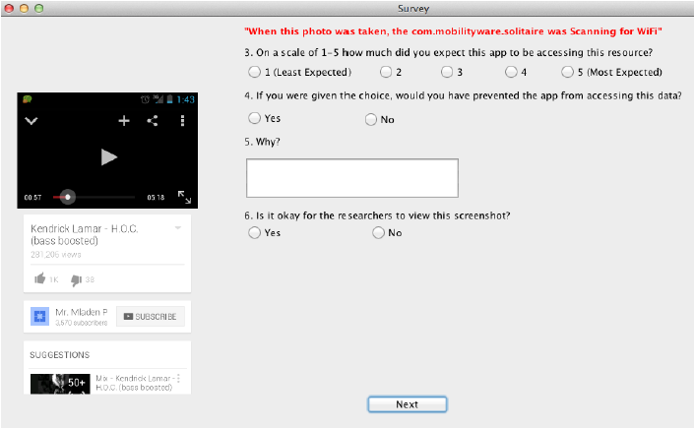
Exit Survey

Slide 14
Outline
Problem statement
Data collection
Application behaviors
Invisible permission requests
High frequency requests
Feasibility of runtime requests
User expectation & reactions
Model users’ decision
Conclusion
Quiz

Slide 15
Invisible Permission Requests
Invisible permission requests
The requests that users don’t know they occur
Five application states with regard to visibility to users:
Visible foreground application (12.04%)
Invisible background application (0.70%)
Visible background service (12.86%)
Invisible background service (14.40%)
Screen off (60.00%)

Slide 16
Invisible Permission Requests
Five application states with regard to visibility to users:
Visible foreground application (12.04%)
Invisible background application (0.70%)
Visible background service (12.86%)
Invisible background service (14.40%)
Screen off (60.00%)
Invisible permission: 75.1%

Slide 17
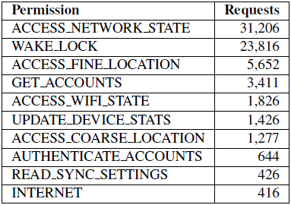
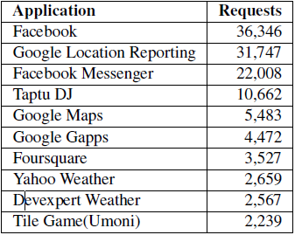
Invisible Permission Requests
Most frequently requested permissions with zero visiblity to users (per user/day)
Network: every 3 seconds
The apps making the most permission requests while invisible to users (per user/day)
Notes:
Checking for Internet connectivity

Slide 18
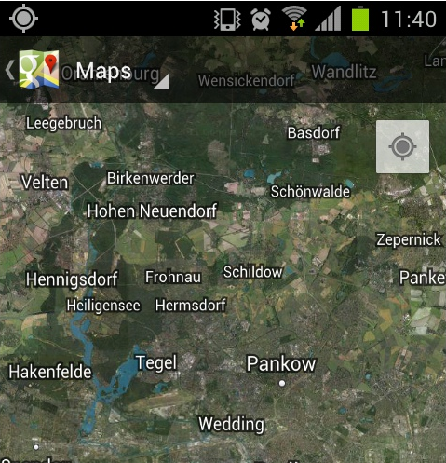
Invisible Permission Requests
Low visibility of location tracking
GPS location provider (0.04%)
Cellular tower (66.1%)
Wifi (33.3%)
Network provider (0.08%)
Cashed location (0.48%)
GPS notification icon appear 0.04% of access of location
Notes:
Alternative ways to infer location.

Slide 19
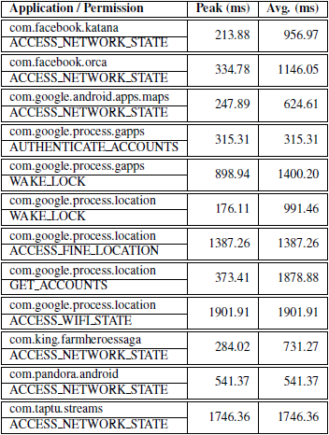
High Frequency Requests
Exception of Google’s apps, all the other apps make excessive requests for phone’s connectivity state
Adverse effect on performance and battery life
Notes:
Permission requests occur very frequently
Not leak sensitive information, still

Slide 20
Feasibility of Runtime Requests
Observations:
8 requests per minute/user
4 exposes per minute/user (15 seconds)
Every other permission request exposes data
Frequency is too high to prompt users in runtime
Sensitive permission requests (per user/day) when apps visible/invisible to users
Notes:
Data exposed: the subset of permission-protected requests that resulted in sensitive data being accessed.
Getbestlocation: Get best location provider

Slide 21
Outline
Problem statement
Data collection
Application behavior
User expectation & reactions
Model users’ decision
Conclusion
Quiz

Slide 22
User expectation & reactions
Screenshots + permission requested: users want to block 35% of 432 permission request
53% of denied permissions are perceived as functionally irrelevant
“It wasn’t doing anything that needed my current location”
32% of denied permissions are privacy sensitive
“SMS messages are quite personal”
Notes:
When viewing screenshots of what they were doing when an application requested a permission

Slide 23
User expectation & reactions
What factors influence users’ desires to block requests?
Identifying permissions
Visibility
Privacy preferences
Expectation
Users are more likely to block invisible, unexpected requests.
Notes:
Expectation:

Slide 24
Outline
Problem statement
Data collection
Application behavior
User expectation & reactions
Model users’ decision
Conclusion
Quiz

Slide 25
Model users’ decision
Use contextual data to examine users’ desire to block certain permission requests
Permission types
Visibility of application
Application name
User ID
A classifier to determine when to prompt users

Slide 26
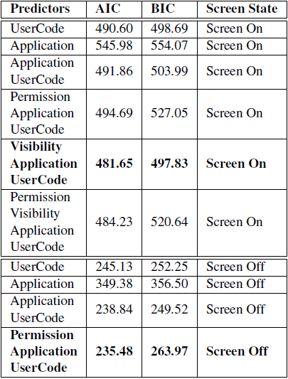
Model Selection
Binary logistic regression model
Permission types
Visibility of application
Application name
User ID
Two separate models based on the screen state result in better fit than a single model with screen state as a fixed effect

Slide 27
Predicting User Reactions
Regression Model
Screen on: visibility, application, user (AUC=0.7)
Screen off: permission, application, user (AUC=0.8)
Different users have different preferences
One size-fit-all policy will not be effective

Slide 28
Conclusion
A first field study to quantify the permission usage by third party applications under realistic circumstances.
Show that participants want to block access to protected resources a third of time.
Model users’ decisions and show how a runtime classifier may be able to determine when to confront users with permission decisions.

Slide 29
My opinion
Data collection procedure is very good. (Screenshot)
Find some interesting results
Small dataset (1 week)
Validity of dataset?
Classification is very week.
Take more factors into consideration
Time, location, personalization…
Only analyze the user’s attitude towards permission requests from apps. Don’t know why app request permission to protected resources.
Notes:
How to guarantee activeness of participants.

Slide 30
Quiz
What’s the functionality of Android Permission?
What are invisible permission request?
Is it feasible to prompt users whenever sensitive data are accessed at runtime?

Slide 31
Thank you!

